Slide 1
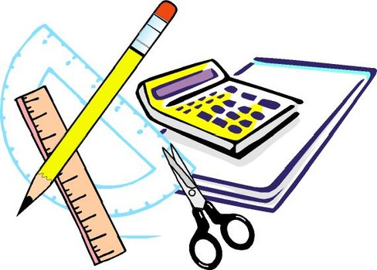
Learning Objective
I will review measures of centre and spread
Enter quietly, please be ready with the following on your desk:
Whiteboard
Whiteboard marker
Exercise Book
Pencil, pen, ruler and red pen
Diary
Calculator
Device – charged or borrowed from Library before maths

Slide 2

Activate Prior Knowledge
CFU 1
What does numerical data consist mainly of?
Numerical data (quantitative data) is data which consists mainly of numerical values or numbers
CFU 2
What does categorical data consist mainly of?
Categorical data ( qualitative data) is data which consists of categories or descriptive terms

Slide 3
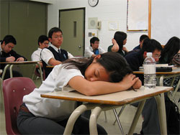
Activate Prior Knowledge
CFU 1
What is numerical data divided into?
Numerical Data can be divided into
discrete data
continuous data
CFU 2
What is one characteristic of discrete data?
Discrete Data:
data which can only take on particular values
data that can be counted
CFU 3
What is another characteristic of discrete data?
CFU 4
What is an example of discrete data?
Examples of discrete data: shoe size, goals scored, number of students in the class, dress size, grade on
your report, number of apples, number of
languages a person speaks, number of people
sleeping during a statistics class
CFU 5
Why is shoe size discrete data?
Vocabulary
Discrete data

Slide 4

Activate Prior Knowledge
CFU 1
What are the two types of data?
Numerical Data can be divided into
discrete data
continuous data
CFU 2
What are the characteristics of continuous data?
Continuous data:
data which can take on any value
data that can be measured
Includes decimals and fractions
CFU 3
What is an example of continuous data?
Examples of continuous data: height, weight,
length, time, money, temperature
Vocabulary
Continuous Data

Slide 5
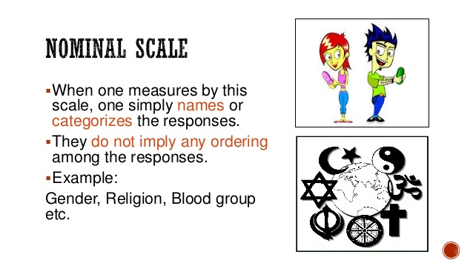
Activate Prior Knowledge
CFU 1
What are the two types of categorical data?
Categorical data can be divided into
Nominal data
Ordinal data
CFU 2
What is nominal data?
Nominal data :
Refers to the name of something
CFU 3
What is an example of continuous data?
Examples of nominal data: the colour of a car,
the model of a car, your suburb, your school,
a subject you study, pass/fail on a test
Vocabulary
Continuous Data

Slide 6

Activate Prior Knowledge
CFU 1
What are the two types of categorical data?
Categorical data can be divided into
Nominal data
Ordinal data
CFU 2
What is ordinal data?
Ordinal data:
Refers to some order associated with the data
CFU 3
What is an example of ordinal data?
Examples of ordinal data: survey requiring an answer
of agree/strongly agree/disagree, position in a
Running race, phone survey 3(excellent), 2(satisfactory), 1(poor), Clothes sizes s/m/l/xl
Vocabulary
Ordinal Data

Slide 7

Activate Prior Knowledge
CFU 1
What are the two types of collected data?
Data collected for Investigations
secondary data
primary data
CFU 2
What is secondary data?
Secondary data: data collected by someone else
Primary data: data collected by yourself
CFU 3
What is primary data?
Secondary data Examples: data from the internet, data from census in 2019, data from a world record book
Primary data Examples: data collected by yourself – go door to door and survey people’s number of pets, survey the students at school who would like more drink fountains

Slide 8
Activate Prior Knowledge
Measures of Centre
Mean
The symbol for mean is $\overline{x}$ or µ.
sum of data values
Mean =
number of data values
An example:
1 + 2 + 3 + 4 + 5
15
For this data set:
Mean =
=
= 3
5
5
1, 2, 3, 4, 5

Slide 9

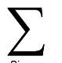
Activate Prior Knowledge
CFU 1
What does the symbol Sigma represent?
Sigma is the symbol which represents “the sum of” or “the addition of” a series of numbers
CFU 2
Draw the symbol Sigma on your white board?
Consider the following data set: 4, 7, 2, 4
Then 4, 7, 2, 4 = 4 + 7 + 2 + 4 = 17
This is read as: “the sum of 4, 7, 2, 4 = 17 “

Slide 10
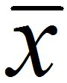
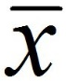

Activate Prior Knowledge
CFU 1
How is “x-bar” read?
is read as “x-bar”
CFU 2
What is “x-bar” known as?
It is known as the “sample mean” – ie the mean of the sample of data
Then = $\frac{ x }{n}$ = $\frac{8+7+2+3}{4} =5$
This is read as: “the mean of the set of data is 5”

Slide 11
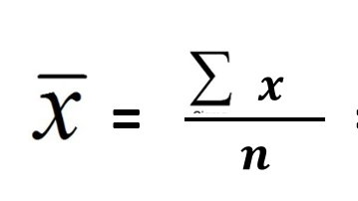
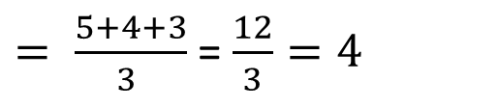
Activate Prior Knowledge
CFU 1
What is the mean?
Mean: is the total of the data values divided by the number of values
CFU 2
How is the mean calculated?
It is written as :
Find the mean of 5, 4, 3:
$= \frac{5+4+3}{3 }$ = $\frac{12}{3}=4$

Slide 12
Activate Prior Knowledge
Measures of Centre
sum of data values
Mean =
number of data values
Find the mean of the following data sets.
7, 9, 2, 4, 3
15, 7, 12, 10
11, 12, 11, 13, 17, 13, 12, 15
7 + 9 + 2 + 4 + 3
Mean =
5
25
=
= 5
Mean = 11
Mean = 13
5

Slide 13
Activate Prior Knowledge
Measures of Centre
Median – The median is the middle value of an ordered data set.
The symbol for median is $\tilde{x}$ or $Q2$.
To find the Median
Step 1: Order the numbers from smallest to largest
Step 2: Find the middle number*
*If the middle is between two numbers, then add them up and divide by two.
For this data set:
Order from smallest to largest.
9, 3, 9, 7, 5, 4
3, 4, 5, 7, 9, 9
Median =
$$\frac{5+7}{2}$$
= 6
Find the middle.

Slide 14
Activate Prior Knowledge
Measures of Centre
Median – The median is the middle value of an ordered data set.
Find the median of the following data sets.
7, 9, 2, 4, 2
12, 11, 19, 10
11, 12, 11, 13, 17, 13, 12, 15
2, 2, 4, 7, 9
10, 11, 12, 19
Median = 4
Median = 11.5
Median = 12.5

Slide 15
Activate Prior Knowledge
CFU 1
What is the median?
Median: is the middle data value when the values are placed in order
CFU 2
How is the median calculated for an odd set of data values?
Find the median of (even set of data): 5, 4, 1, 8, 3, 5,
CFU 3
How is the median calculated for an even set of data values?
Place the data in order (eg lowest to highest): 1, 3, 4, 5, 5, 8
Count in from each end to find the 2 middle data values : 1, 3, 4, 5, 5, 8
Find the mean of the two middle data values: (4 + 5) ÷ 2 = 4.5
The median of the data is 4.5

Slide 16
Activate Prior Knowledge
Measures of Centre
Mode – The mode is the value that occurs most often in a data set.
The symbol for mode is $Mo$.
An example:
For this data set:
Mode =
11
9, 11, 13, 11, 12, 10

Slide 17
Activate Prior Knowledge
Measures of Centre
Mode – The mode is the value that occurs most often in a data set.
Find the mode of the following data sets.
7, 9, 2, 4, 2
15, 7, 12, 10, 7
11, 12, 11, 13, 17, 13, 16, 15
Mode = 2
Mode = 7
Mode = 11, 13

Slide 18
Activate Prior Knowledge
CFU 1
What is the mode?
Mode: is the most common data value
CFU 2
What can a data set have?
Data sets can have no mode, one mode, two modes
Find the mode of: 3, 4, 2, 1, 8
CFU 3
What can a data set have?
The Data set has no mode as there is only 1 of each data

Slide 19
Activate Prior Knowledge
CFU 1
What is the mode?
Mode: is the most common data value
CFU 2
What can a data set have?
Data sets can have no mode, one mode, two modes
Find the mode of: 3, 4, 2, 1, 8, 8
CFU 3
What can a data set have?
The Data set has one mode which is 8

Slide 20
Activate Prior Knowledge
CFU 1
What is the mode?
Mode: is the most common data value
CFU 2
What can a data set have?
Data sets can have no mode, one mode, two modes
Find the mode of: 3, 4, 2, 2, 1, 8, 8
CFU 3
What do we call a data set which has 2 modes?
The Data set has two modes which are 2 and 8
This data set is called: bimodal

Slide 21
Activate Prior Knowledge
Measures of Spread
Range – The range shows how far the data is spread out.
The symbol for range is $R$.
Range = (largest data value) – (smallest data value)
An example:
For this data set:
Range = 9 - 1
= 8
6, 9, 3, 1, 7, 8
Identify the min and max.

Slide 22
Activate Prior Knowledge
Measures of Spread
Range = (largest data value) – (smallest data value)
Find the range of the following data sets.
7, 9, 2, 4, 2
15, 7, 12, 10, 7
11, 12, 11, 13, 17, 13, 12, 15
Range = 9 - 2
= 7
Range = 8
Range = 6

Slide 23
Activate Prior Knowledge
Outliers
Outlier – Outliers are unusual or extreme data values that do not fit the rest of the data set.
An example:
1, 3, 5, 2, 6, 3, 73, 4, 1, 7
Mean = 10.5
Mean = 3.6
Median = 3.5
Removed Outlier
Median = 3
With Outlier
Mode = 1, 3
Mode = 1, 3
Range = 72
Range = 6

Slide 24
Activate Prior Knowledge
Outliers
Outlier – Outliers are unusual or extreme data values that do not fit the .
Remove the outlier and calculate the mean, median, mode and range of the following data sets.
3, 9, 2, 1, 2
15, 17, 12, 3, 12
89, 76, 98, 13
Outlier = 9
Outlier = 3
Outlier = 13
Mean = 2
Mean = 14
Mean = 87.7
Median = 2
Median = 13.5
Median = 89
Mode = 2
Mode = 12
Mode = Undefined
Range = 2
Range = 5
Range = 22

Slide 25
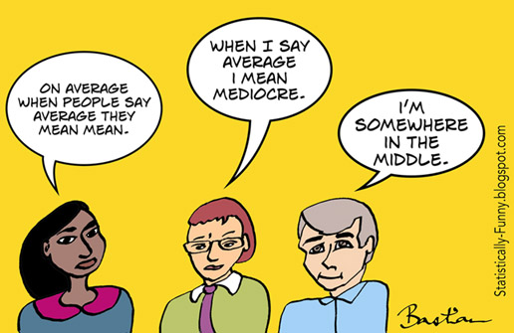
Independent Practice
Mathspace Activity

